Slide 1
TEAM5OARS Demo
By Team 5

Slide 2
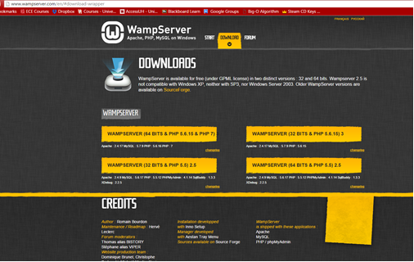
Installing WAMP
Download WAMP from http://www.wampserver.com/en/#download-wrapper and run it.

Slide 3
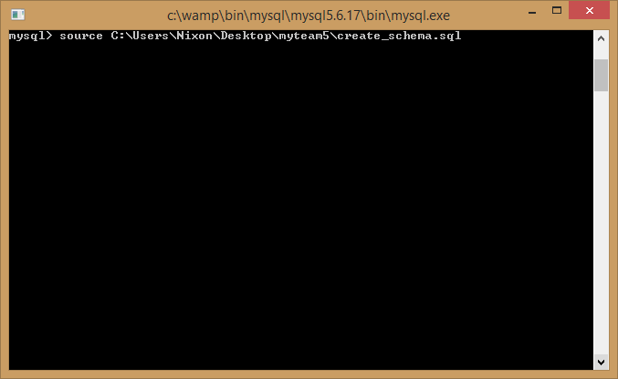
Set up Database
Get the server online to localhost:88
Open the MySQL console and run the script.

Slide 4
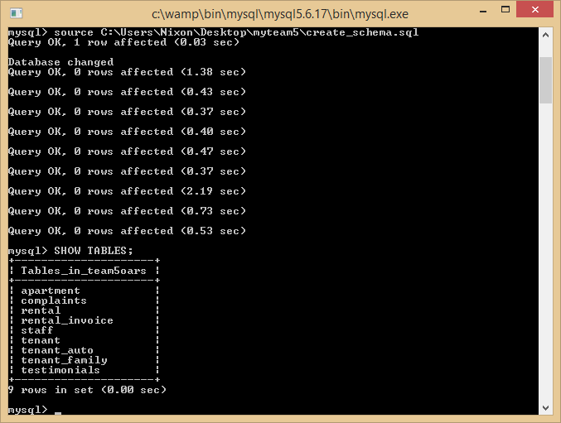
Cont.

Slide 5
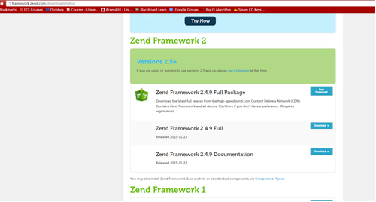
Installing Zend
Download Zend Framework 1.12.17 Minimal http://framework.zend.com/downloads/latest

Slide 6
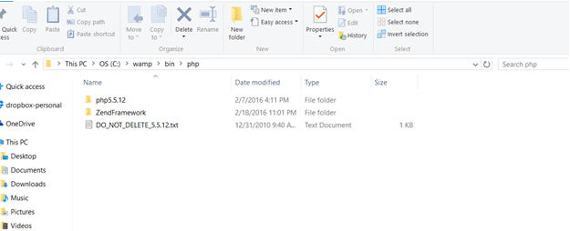
Cont.
Unzip it into the WAMP folder

Slide 7
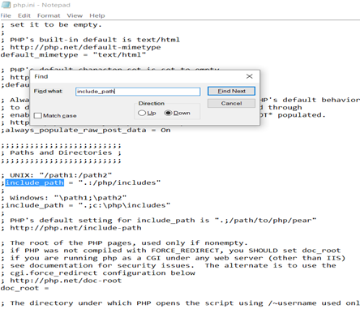
Cont.
Find the php.ini file in C:\wamp\bin\php\php5.5.12\pnp.ini or equivalent
Add Zend to your appropriate include path

Slide 8
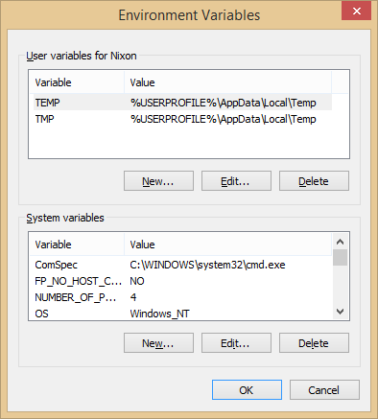
Cont.
Add Zend to the system path.
Go to computer properties > Advanced System Setting > Environment Variable > Path
Add “C:\wamp\bin\php\php5.5.12” to the path

Slide 9
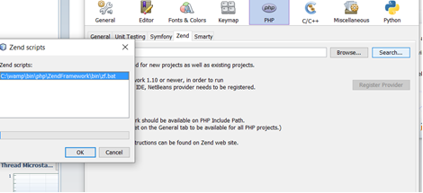
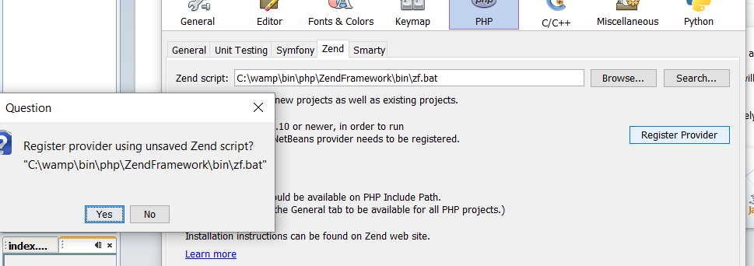
Cont.
Install Zend into Netbeans
Go to Tools > Options > PHP > Zend.
Search for Zend script and run it.

Slide 10
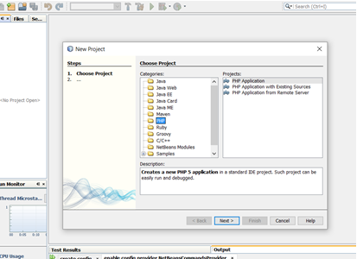
Create Project in Netbeans

Slide 11
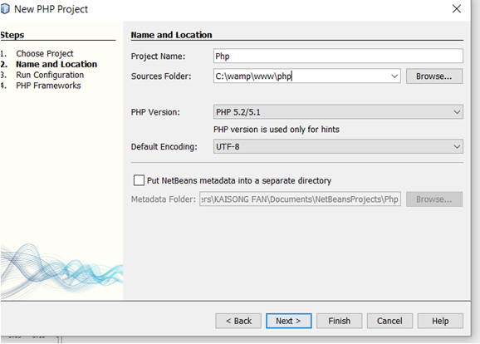
Cont.
Making sure to set sources into the WAMP folder

Slide 12
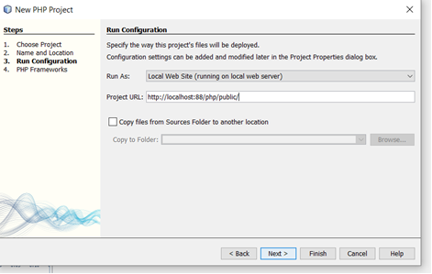
Cont.
Set the run configuration

Slide 13
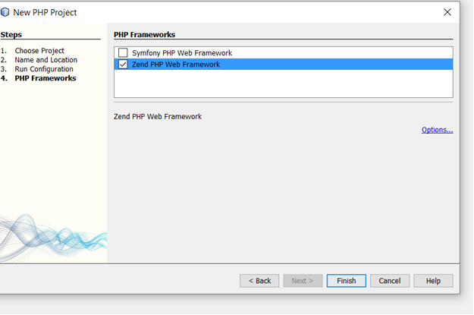
Cont.
Ensure that Zend is selected and Finish

Slide 14
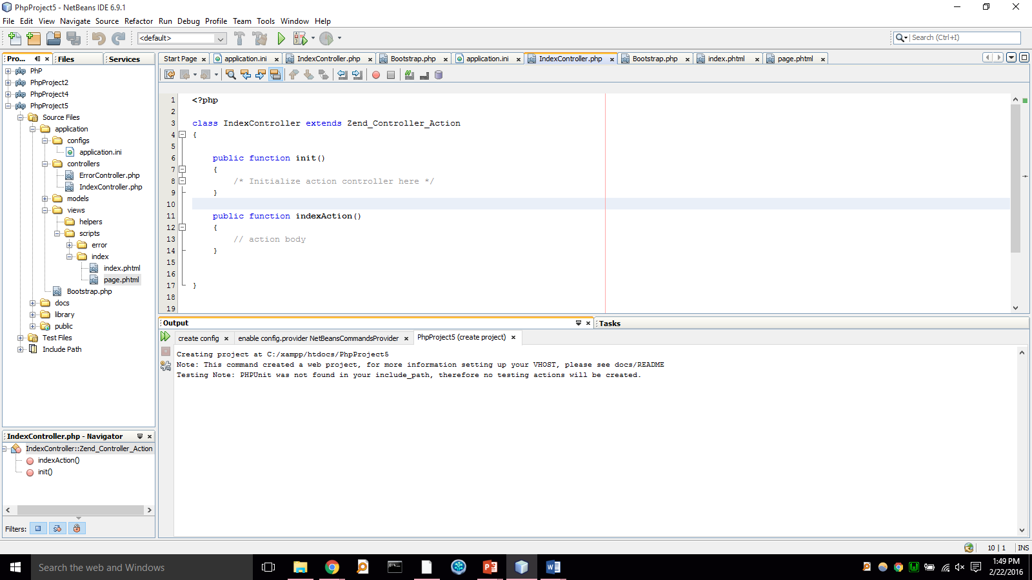

Slide 16
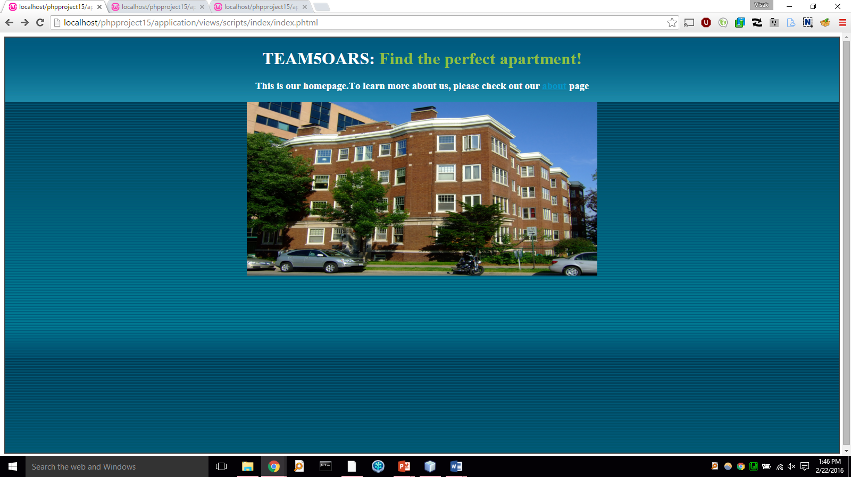

Slide 17
